Slide 1
Book Recommender System
Guided By:
Prof. Ellis Horowitz
Kaijian Xu
Group 3
Ameet Nanda
Bhaskar Upadhyay
Bhavana Parekh

Slide 2
Introduction
A comparison between 2 different algorithms (Content Vs Collaborative based filtering) for a Book Recommender System.
Based on the result of the experiment infer which algorithm offers better recommendations.
We find the related dataset from …
http://www.informatik.uni-freiburg.de/~cziegler/BX/

Slide 3
Technologies Deployed
MySQL – To store the dataset R1- For Books, Users, Ratings.
50k books
~37k users
~500k ratings
~5 million item-item matrix elements
PHP –Backend for connectivity between html and sql and data processing.
Perl – To scrape data from amazon.com
Apache – Web Server
HTML/JavaScript /AJAX/Jquery – Front end UI for entering artist query and displaying results

Slide 4
Content Based Recommender
Primary Content from Dataset – Author
Additional Content from Dataset – Age group
What we wanted to achieve?
Given a set of books already rated by a user, suggest other books based on users favorite author.
Suggest trending books based on the age of the user.
Challenges:
Find favorite author
Find a relevant age group
Measuring the distribution of ratings

Slide 5
Simple Recommendation - II
How we accomplished (Algo_content_based_authors ())
Find the highest rated books from the user profile
Group them by authors and order by mean rating per author
Select these authors and find cumulatively highest rated books by them and suggest to users.
Suggest to the user books which he hasn’t read from last step.
For books trending by age we change the attribute from authors to age.
For the age of the user, find all books rated by the users of the same age.
Find the cumulative rating (bookcount * average) and suggest users whose cumulative rating is greater than threshold.

Slide 6
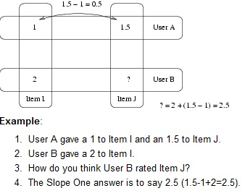
Slope one Collaborative Recommender
Slope One is based on a simple “popularity differential” which we compute by subtracting the average rating of the two items.

Slide 7
Implementation Steps
Created and populated the item-item matrix (Dev table) with the sum of the Differential ratings and the count of the total users who rated the item pair.
Differential Rating
Each time a new user rating is entered, we update this item-item matrix Dev table.
CHALLENGES:
Exponential time complexity
Space issue for population of DEV table
ISBN1 | ISBN2 | Count | Sum

Slide 8
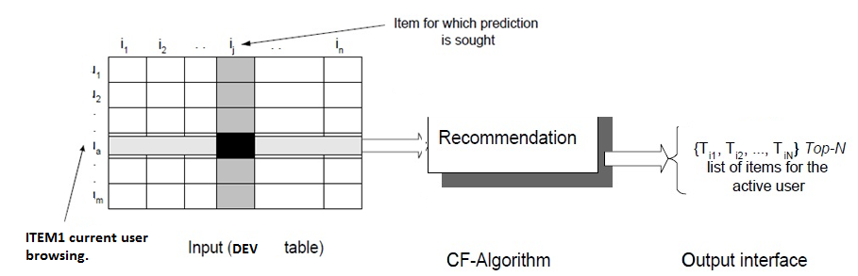
Non personalized : using Dev Table
Retrieve itemID2 for recos based on higher values of Count
Count is the number of users who have rated itemID1 and itemID2
Retrieve itemID2 based on highest values of (sum/count)
Sum is the sum rating difference of ItemID1 from ItemID2, for all the users who rated both items.
Sum/Count gives us the popularity difference of the item pair.

Slide 9
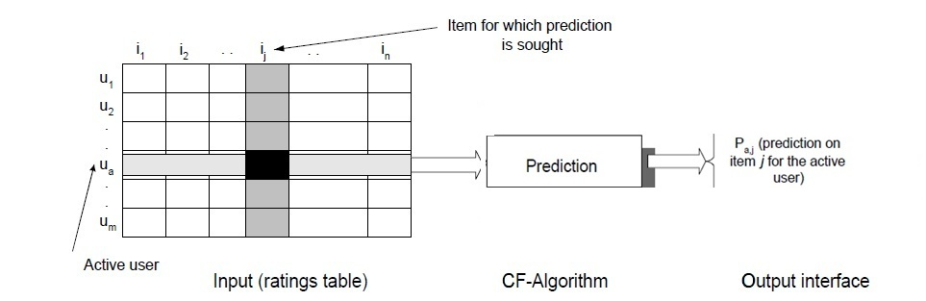
Personalized
We define a predict function to predict how the current user will rate the item. For current user we predict the top 5 items.
Find all ISBN1 books from DEV table where ISBN2 is rated by current User.
Find the items having highest average rating based on sum and count values from Dev table and ratings table.

Slide 10
Experiment and Results
We created a test set of 12 users.
Duplicates of already existing users
Each user with more than 10 rated books
Removed 60% of known ratings
Tested the test data set with simple content based and collaborative algorithms
Match is the number of books from the recommendation which were present originally in the users rated books.
Collaborative gave better results than content based, for fewer content in our case

Slide 11
Performance Comparison of Prediction Accuracy

Slide 12
Inference
Content based Recommender
Prediction accuracy proportional to number of content attributes
Gets complicated with increase in content parameters
Collaborative based Recommender
More accurate predictions
Easier to implement
Non-personalized & Personalized

Slide 13
Additional Features
Amazon scraping to return most popular books
Jquery based UI
Auto-Suggest search feature
User login sessions

Slide 14
Challenges & Future improvement
Sparse Matrix for Ratings
Query Optimization.
Improvements :
Co-relate between different attributes to improve the quality of content based recommendations.
To make a hybrid model using both collaborative filtering algorithm and content based filters.
To test the program with larger data sets and more attributes.
To run algorithms in parallel/distributed environments.

Slide 15
Demo

Slide 16
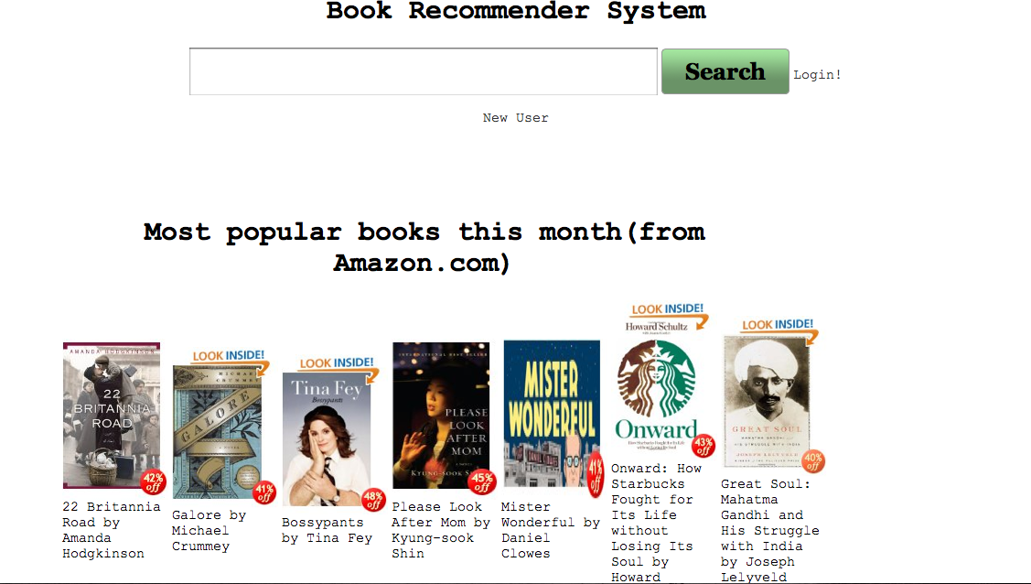
Login Page

Slide 17
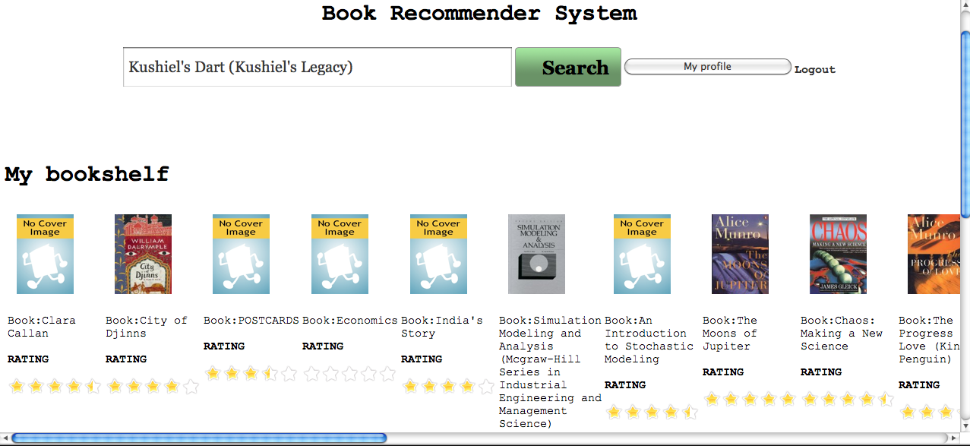
User Profile

Slide 18
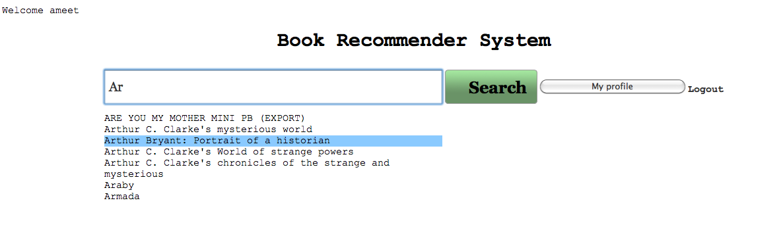
Search (Auto suggest)

Slide 19
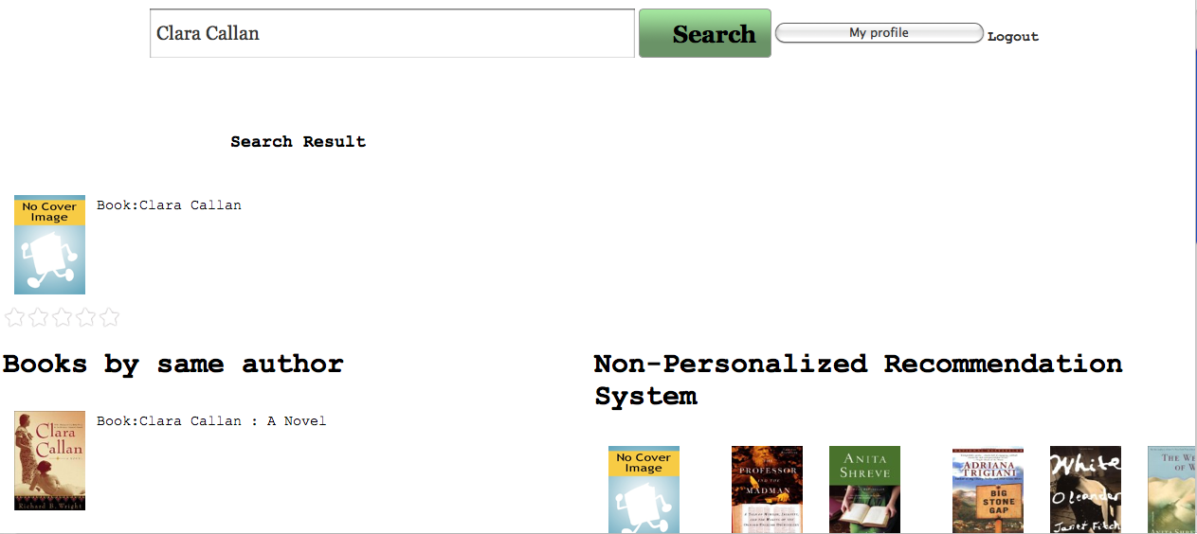
Search result with recos

Slide 20
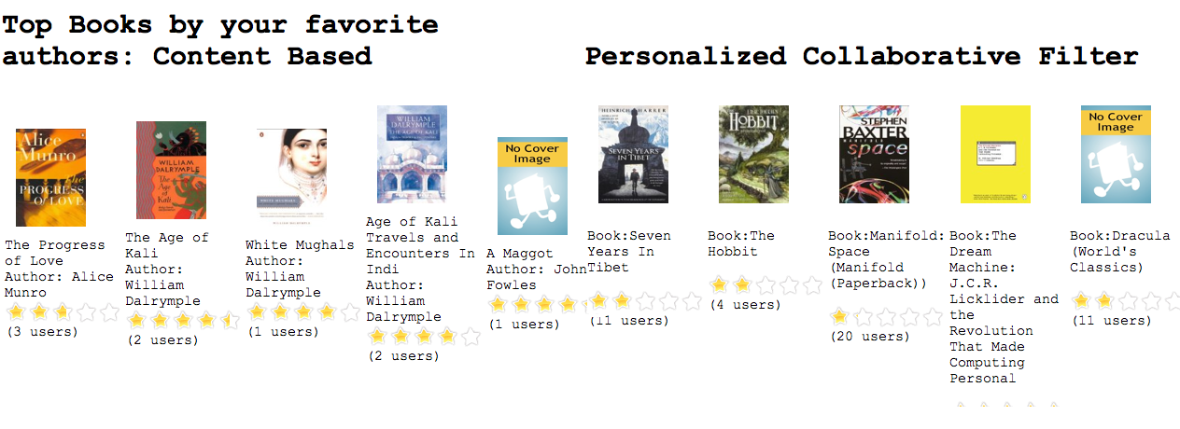
Recommendations

Slide 21
Fin

